Slide 1

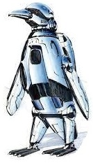
TrackIO: 5G Tracking First Responders Inside-Out
Authors: Ashutosh Dhekne, Ayon Chakraborty, Karthikeyan Sundaresan, Sampath Rangarajan with the University of Illinois at Urbana-Champaign and NEC Labs America, Inc.
Jina Wilde with The Future Penguin group | hkl690

Slide 2
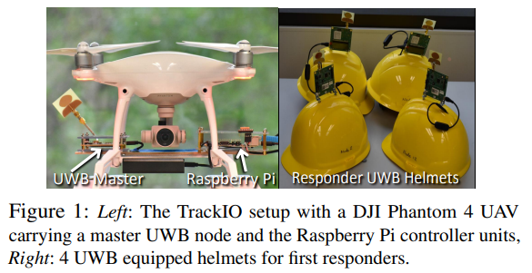
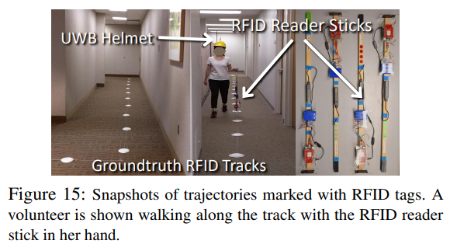
TrackIO: Abstract
TrackIO is a research project that seeks to help first responders inside buildings which can be very difficult to navigate in emergency situations where there may be limited visibility due to smoke, fire, or other dangerous events. The researchers created TrackIO, a system that acts as mobile infrastructure where there is none to track responders in large indoor environments mainly with the help of unmanned aerial vehicles (UAVs) with ultra-wideband (UWB) radio technology that is very fast, secure, and accurate for short ranges. Mathematical and scientific analysis was recorded, along with experiential data with the use of 4 UAVs and 4 UWB helmets as shown in Figures 1 and 15.

Slide 3
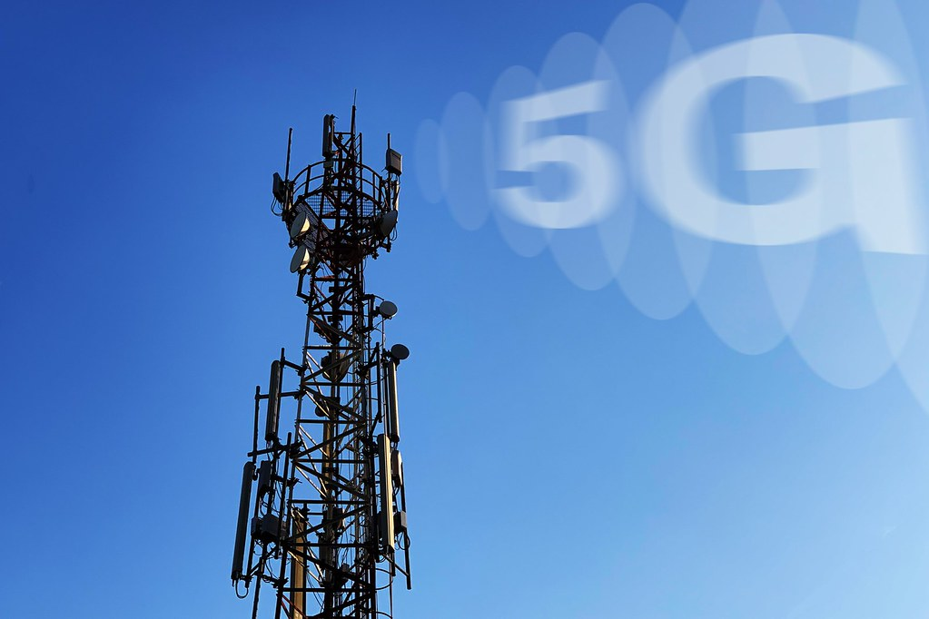
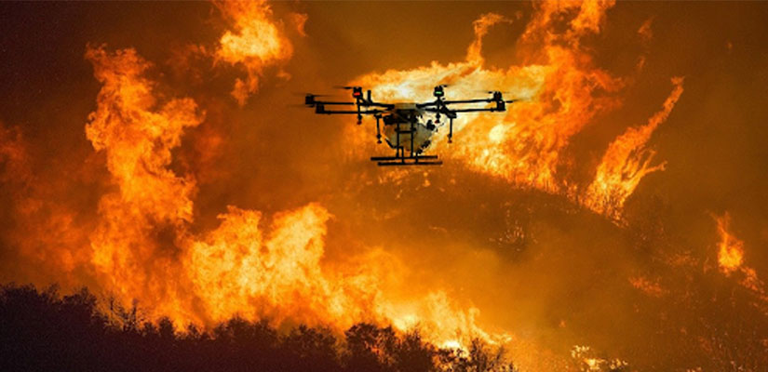
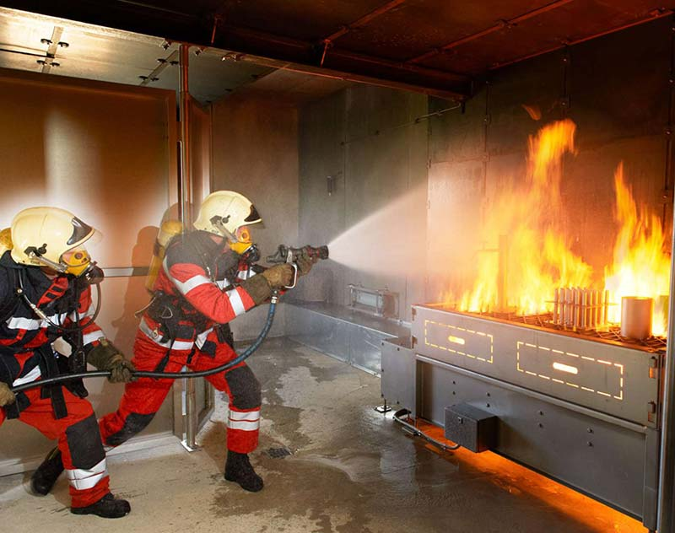
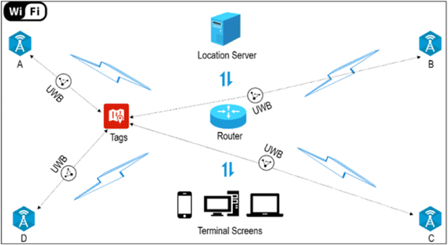
TrackIO & The Term Project
My group’s term project is the First Responder Tracker, a 5G, IoT, and Ultra Wideband (UWB) based tracking system to aid emergency situations. It will be built on previous technologies, but expanding the capabilities further. Research has shown this is a developing field with many limitations. 5G technology will enable faster data transmission from sensors, cameras, and detection devices for real-time analytics and better decision-making. The federal government is the market segment target, and firefighters will be the main end users. Monetization will focus on this target audience. The end user benefits are that first responders will have more data to allow for greater safety in dangerous situations before, during and after emergencies.
Notes:
Why it matters to your term project

Slide 4
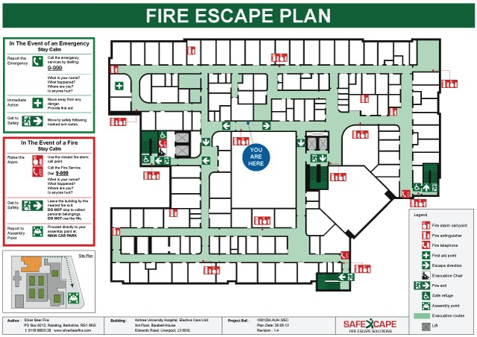
TrackIO & The Term Project
Our team will continue researching solutions and applications for the First Responder Tracker system. The TrackIO research paper has directly inspired our group with their findings of real-world experiments and data analysis. UWB seems like the best choice for indoor tracking due to the problems GPS has penetrating through walls and even cluttered offices. The researchers for TrackIO also describe the need for outdoor infrastructure to support technology to be able to use more mobile technology to aid emergency situations.
The researchers described four initial challenges in beginning their project for using UAVs to track first reponders: the responders’ mobility indoors over time including turning, indoor coverage of UWB is limited to tens of meters, real-time tracking to collect ranging measurements for multiple UAVs and responders (called UWB nodes) is not scalable in a large network, and absolute location fix has a margin of error of around 2-3 meters for lower-end UAVs.
Notes:
Why it matters to your term project

Slide 5
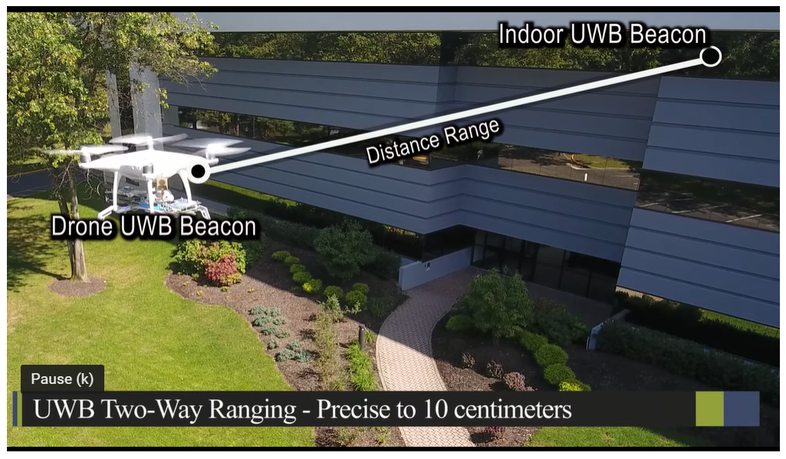
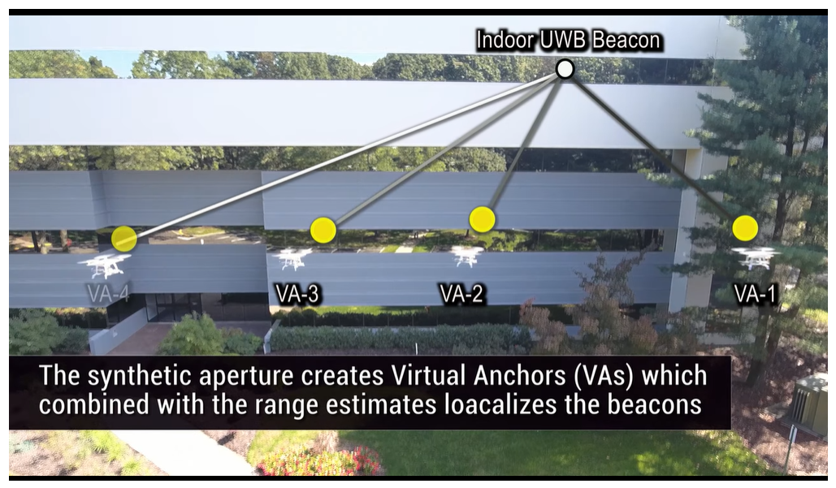
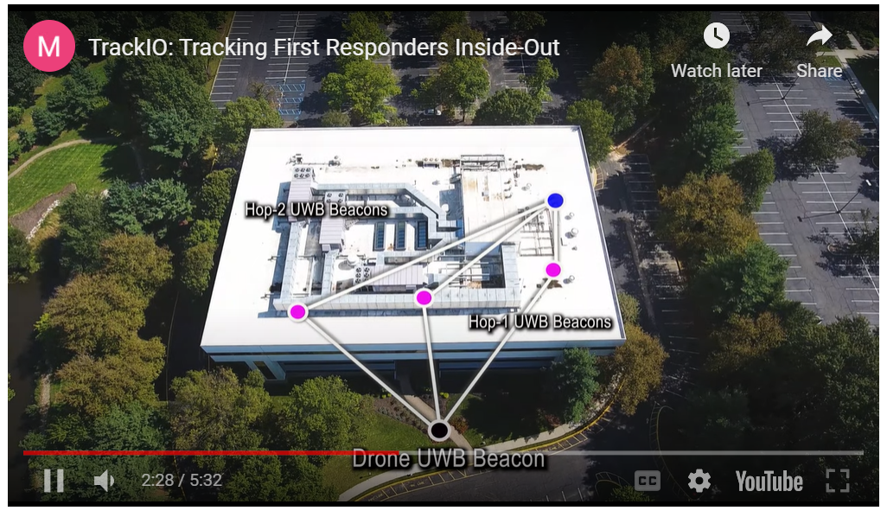
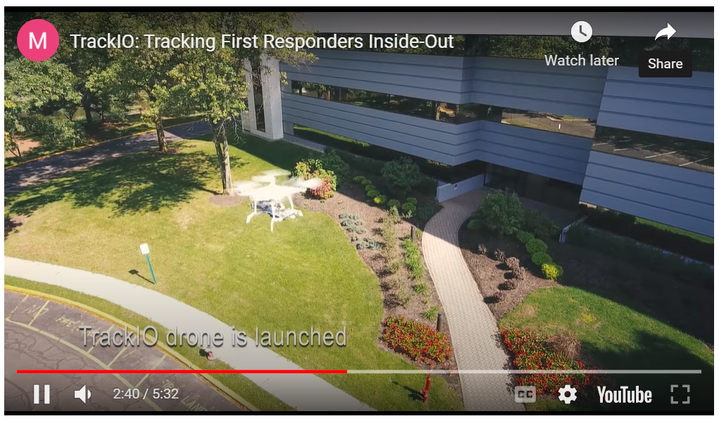
TrackIO: Addressing the Challenges
TrackIO addressed these initial challenges with four novel design elements: trajectory tracking that included responders’ velocity estimates and not just their location, multi-hop localization paradigm where responders reached by UAV (hop1) serve as anchors for neighboring nodes (hop2) that cannot be reached by UAV, concurrent ranging protocol which tranforms UWB’s sequential ranging protocol and achieves three times speed-up which allows for real-time tracking, and reverse location look-up which uses UWB beacons positioned on roof corners of a responder service vehicle, with one beacon also equipped with a GPS reciever which gives highly accurate estimates over time for accurate UAV localization even with mobility.
TrackIO Demo Video Screenshots from https://www.nec-labs.com/trackio
Notes:
Why it matters to your term project

Slide 6
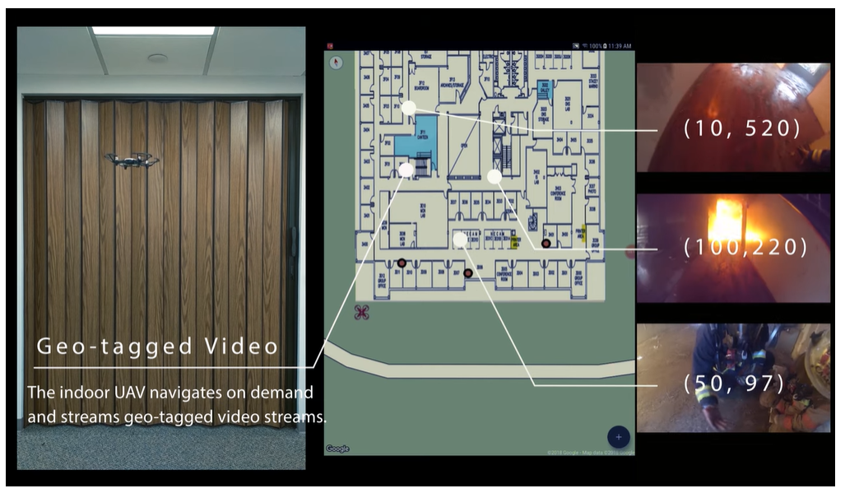
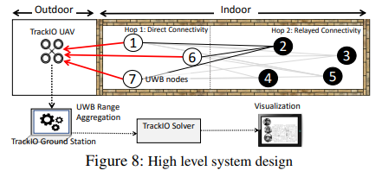
TrackIO: Geo-Tagged Video Tests
TrackIO Demo Video Screenshots from https://www.nec-labs.com/trackio
TrackIO was able to geo-tag several points using their indoor UAV (client node) sending range data to the outdoor UWB-UAV (master node) with innovative algorithmic and architectural protocols.
Notes:
Why it matters to your term project

Slide 7
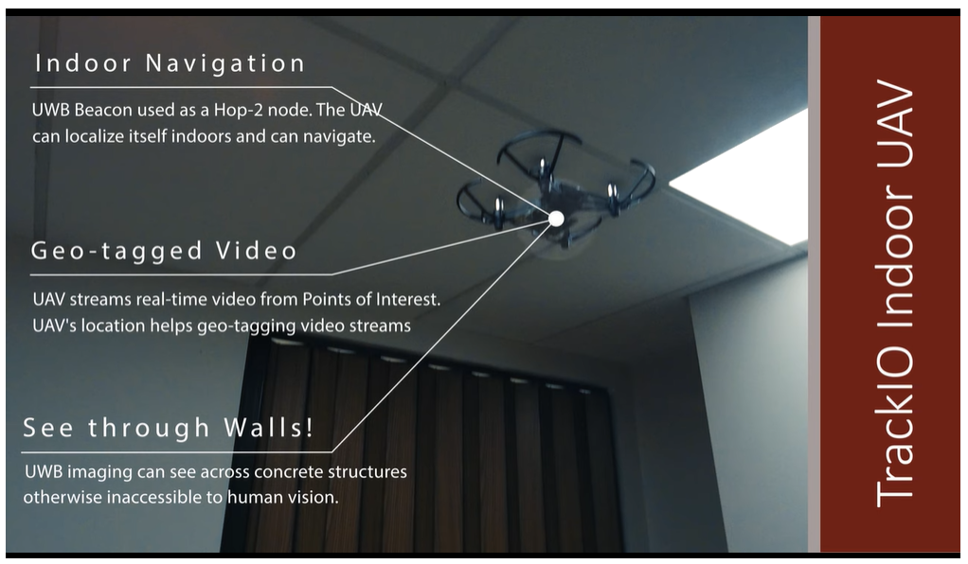
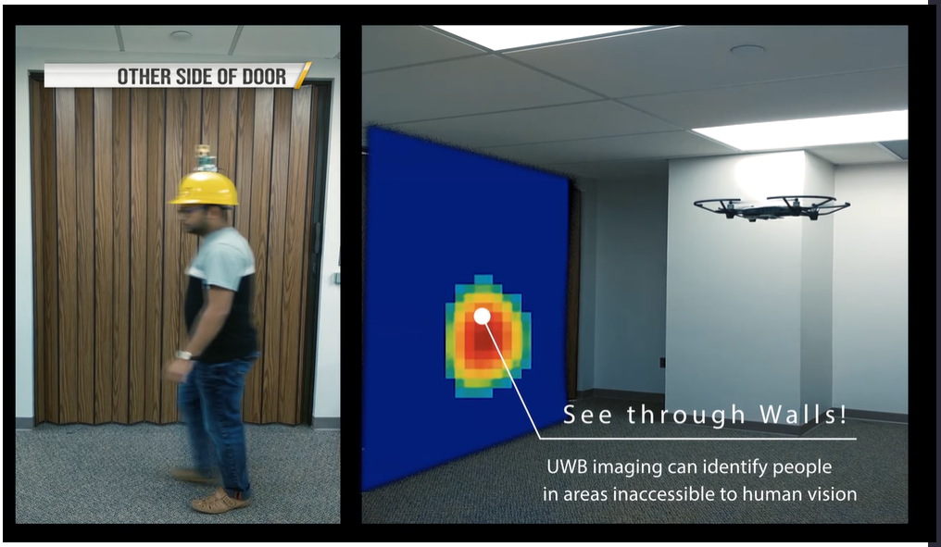
TrackIO: Tests
TrackIO Demo Video Screenshots from https://www.nec-labs.com/trackio
TrackIO researchers analyzed velocity, GPS, end-to-end latency compared to UWB and present technologies. The outdoor infrastructure created by TrackIO is what enables the indoor navigation to be so accurate, along with the research on velocity (turning) for spatial estimation. As shown in the screenshot, UWB imaging on the indoor UAV is even able to “see through walls!”
Notes:
Why it matters to your term project

Slide 8
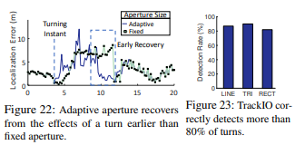
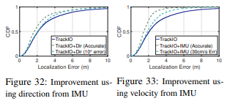
TrackIO: Data Analysis
The TrackIO researchers analyzed data from the UWB beacons to calculate how accurate their velocity estimates were in guiding the indoor localization mapping as seen in data analysis from Figures 22, 23, 32, and 33. The algorithms to incorporate velocity into mapping is unique to TrackIO and is one of their competitive advantages.
Notes:
Why it matters to your term project

Slide 9
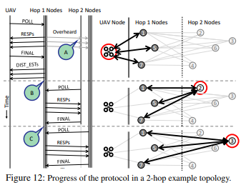
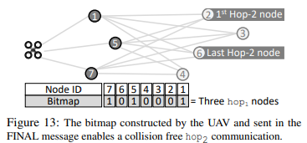
TrackIO: Concurrent Range Protocol
TrackIO has modified the underlying UWB sequential ranging protocol due to its unscalable nature. The hops are designed to send and recieve different messages in order to help calculate distance, the high level design is shown in Figures 12 and 13. The algorithms are very detailed and precise.
Notes:
Why it matters to your term project

Slide 10
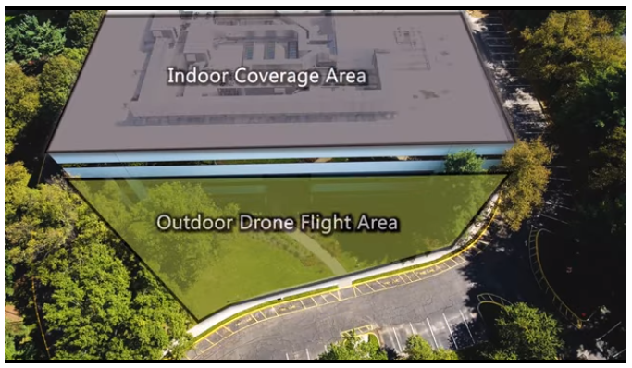
TrackIO: Conclusion
TrackIO’s research focuses on creating outdoor infrastructure for localization mapping with the use of UAVs outside and inside, UWB devices embedded in responder’s equipment such as helmets, and algorithms that calculate and send mapping data quickly and accurately. The problems of indoor mapping for multipaths has led to their TrackIO research.
To watch the TrackIO video demonstration, click on this link: https://www.nec-labs.com/trackio

